Slide 1
Un-authenticated RCE in VMWare NSX Manager
Un-marshalling java objects through user submitted xml and why it’s a bad idea
Fabio Sofer

Slide 2
Those were a lot of keywords, lets take it one step at a time…

Slide 3
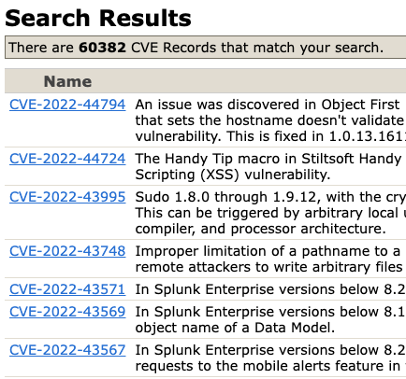
Un-authenticated what?
RCE stands for Remote Code Execution, which is a specific type of Arbitrary Code Execution which specifies that the asset can be expoited remotely, or such as in this case, from the public domain. Un-authenticated prefix in this case means that the attack can be carried on with no need of credentials.
Search results for Arbitrary code/command execution on the CVE Website

Slide 4

VMWARE NSX Manager?
VMware NSX is a network virtualisation and security platform that enables the abstraction of a virtual cloud network. It leverages a software-defined approach to networking that extends across data centers, clouds and application frameworks. NSX Manager is the manager interface/dashboard, which can be interacted with in several ways, including REST APIs, as we will see later.
The unlucky victim

Slide 5
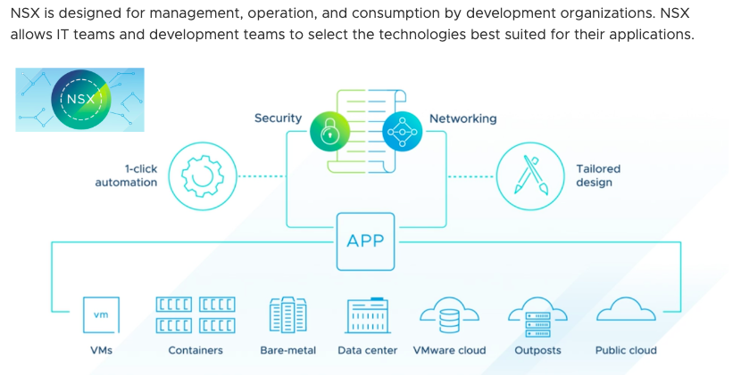
NSX Manager schema
As we can see from the vastity of tasks, it can handle and the size of the target companies, this would be an extremely safety-critical application. Unfortunately, as we will see later, even in corporate-level applications, there is always the chance for critical mistakes.
Operational Schema of the NSX ecosystem

Slide 6
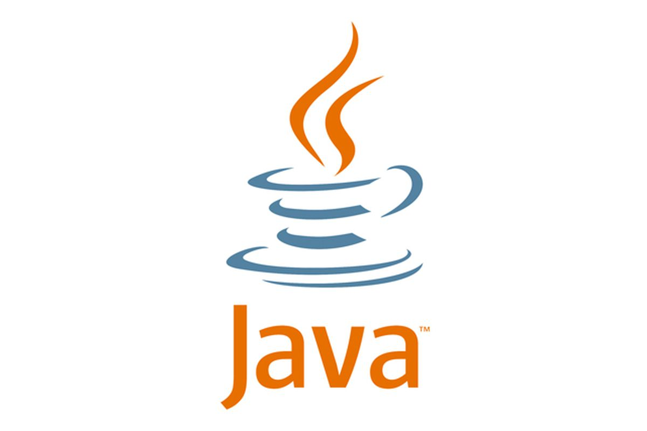

UN-Marshalling ?
Un-marshalling is the action that reverts the operation of encoding a code-defined data structure into an alternative, easy to transport format (bytesteams, json or, as in this case, XML).
In this particular vulnerability, we are specifically talking about the Java programming language and Xstream, a popular library to handle Marshalling and UnMarshalling through XML
Code Ecosystem of this vulnerability

Slide 7
Okay… Now we can start
We will follow the discoveries of the researcher step by step, as I believe it can provide an intresting insight into the job of a security researcher and how they go about their daily work.

Slide 8
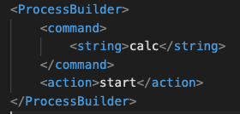
The Xstream vulnerability
In Xsteam versions prior to 1.4.19, the default security behaviour to sanitize user-submitted XML is using blacklists. Already tracked as CVE-2021-39144, this means that if the blacklist is misconfigured by Xstream developer oversight, it could allow us to send a payload like this:
This payload, if unmarshalled without errors, should open the calculator (as an example of ACE) on the machine which does the un-marshalling, in whichever context the java application is running (this includes root, as we will see later)
Example of a Java XML Payload

Slide 9
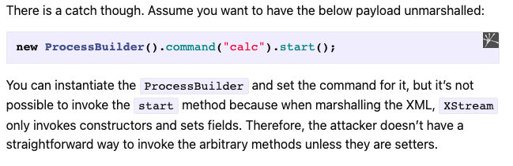
Not so easy…
Unfortunately (from an attacker’s point of view), Xstream only calls constructors and setters for the objects it un-marshalls, so we are not free to call the .start() method of the ProcessBuilder, stopping us from easily expoiting the host machine.
The logical payload we are trying to un-marshal on the target system

Slide 10
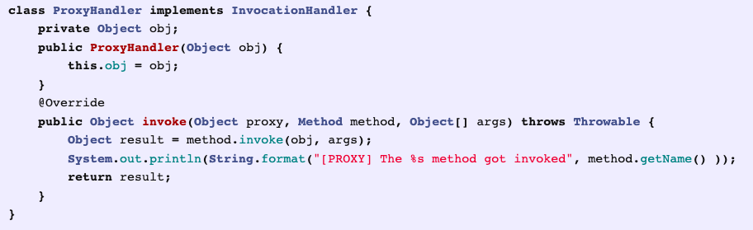
Proxies,handlers and java magic
Thankfully Java offers several ways to re-route calls using wrappers and handlers. In this case, the classes that interest us are two:
Dynamic Proxy: which can delegate any calls for the classes that implement it to another class, they are usually used for pre/post-processing of data.
java.beans.EventHandler : This class can be instantiated to invoke a defined method on another object when a particular method (or even ANY method) is invoked.
An example implementation of a Java dynamic proxy

Slide 11
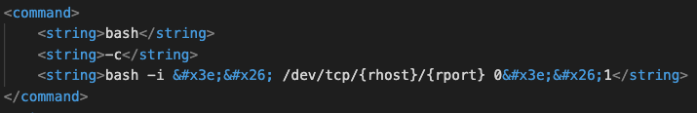
Tcp reverse shell?
A >& followed by a file descriptor is a way to redirect sdout and stderr into the same file descriptor.
In Unix, you can pipe commands into /dev/tcp/anyIP/anyPort to open a TCP connection to that IP and port.
The command beneath opens an interactive shell and tries to connect it to a listening server at rhost:rport(attacker-controlled server). This is called a reverse shell, as the victim opens a shell session towards us (the attacker).
TCP Reverse shell embedded into XML

Slide 12
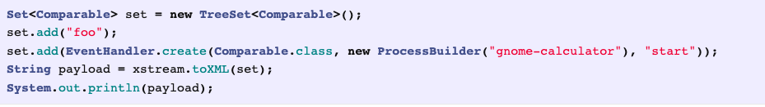
One final step
Now we just need any call to reach our dynamic proxy, which will redirect it to the event handler, which in turn will call our process builder.
We can make this happen inside our payload by means of sorted objects, which get called by the sort() automatically as part of the constructor, causing the RCE.

Slide 13
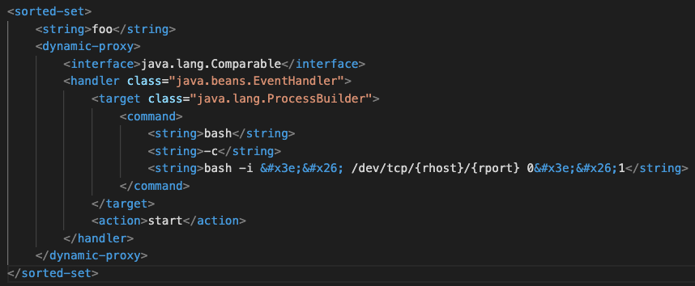
Putting it all togheter
Using all of what we just discussed and putting it together, we get a final payload that looks something like this:
Final XML payload

Slide 14
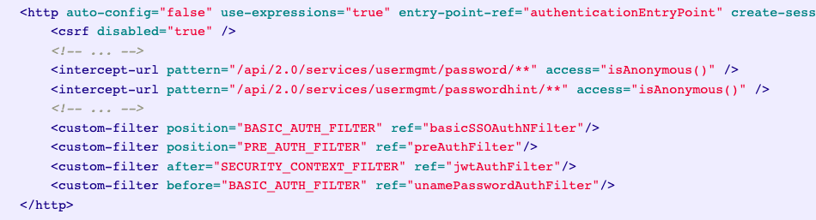
Now for a target…
NSX Manager exposes REST APIs to login users, which take arbitrary XML as input!
The EOL update is still using Xstream 1.4.18 ! (vulnerable to the previous attack ! )
Code snippet from the security-config.xml of VMWare NSX

Slide 15
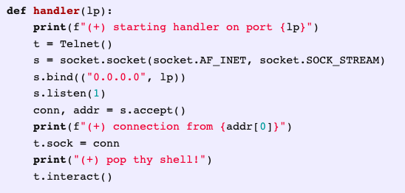
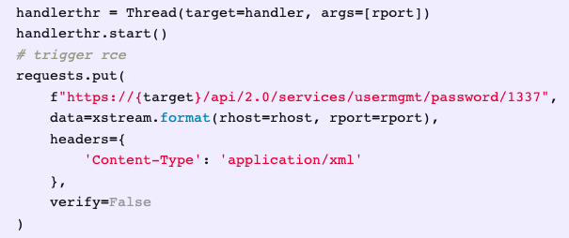
Proof of concept
Having found a vulnerable target, we can now write a quick python script to test that our attack works!
We are creating a thread for running the handler function, which will accept the reverse-shell connection, while we are sending the payload to the vulnerable API endpoint in our main thread.
Python POC developed by the discoverer of this vulnerability

Slide 16

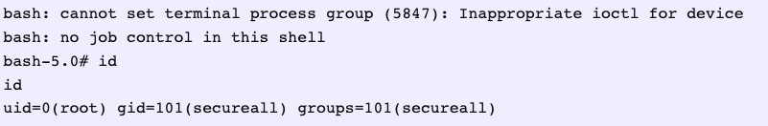
Login process epic fail
Most shocking of all, the login handler on the NSX server has privileged access in order to handle login permissions, so when we interrupt it midway, we are still left with root access!
Command history from real vulnerability tests

Slide 17
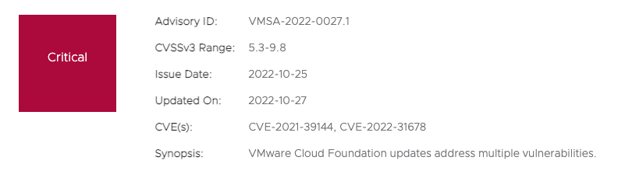
Expected Outcome, unexpected response
Screen caputures from the VmWare security advisory regarding the vulnerability

Slide 18
Conclusions
VMware despite the product being EOL, actually pushed out a patch to fix the issue!
Avoid using blacklists! Whitelists are almost always the better option for input validation!
Any time we have a lot of moving parts, there is the chance to get a much larger attack surface, even out of a minor vulnerability!
Try never to write programs that require the use of the root user, even a single command can be dangerous!
Never trust user input!

Slide 19
Bibliography
Article that made that brought the vulnerability to the spotlight: https://arstechnica.com/information-technology/2022/10/vmware-patches-vulnerability-with-9-8-10-severity-rating-in-cloud-foundation/
In-Depth WriteUp by the researcher who found the vulnerability: https://srcincite.io/blog/2022/10/25/eat-what-you-kill-pre-authenticated-rce-in-vmware-nsx-manager.html
Page of the VmWare security advisory : https://www.vmware.com/security/advisories/VMSA-2022-0027.html
Xstream Vulnerability on CVE: https://cve.mitre.org/cgi-bin/cvename.cgi?name=CVE-2021-39144
CVE on the NIST website: https://nvd.nist.gov/vuln/detail/CVE-2021-39144

Slide 20
Thank you for your time
Fabio Sofer

